Slide 1



Dip in 7
Culture Spot 2
Association game

Slide 2
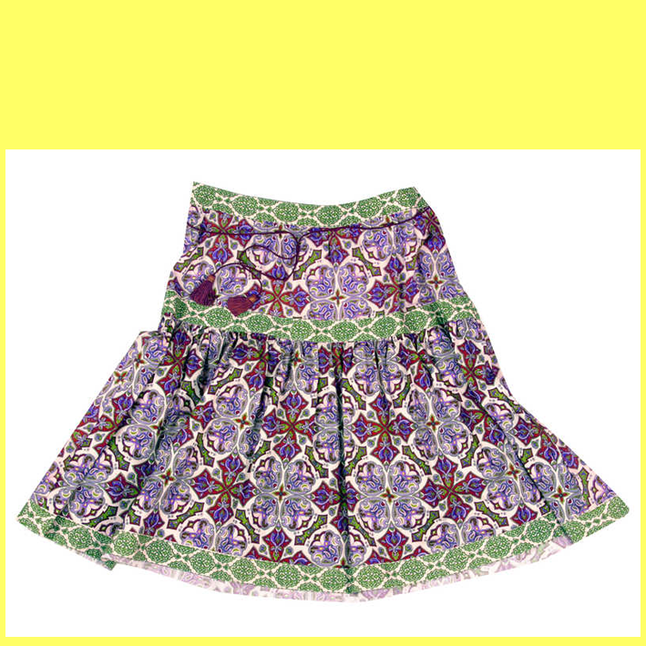

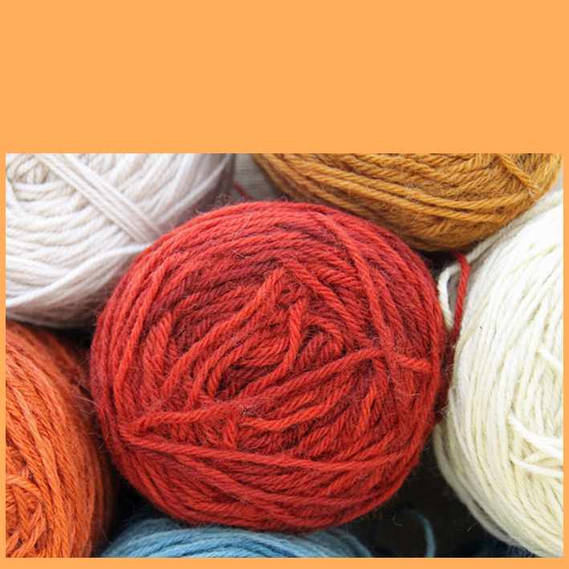


A1
item of clothes
B1
middle-aged
C1
sheep
D1
the Highlands
long
brave
pullover
A2
B2
C2
D2
bagpipes
short
married
soft
tartan
A3
B3
C3
D3
A4
mini
B4
lucky
C4
pure
castles
D4
COLUMN A
COLUMN C
SKIRT
COLUMN B
WOOL
MAN
SCOTLAND
COLUMN D
THE FINAL ANSWER
KILT

